Slide 1
Business Cases: what we’re doing in Canada
Lloyd McKenzie
June 26, 2018

Slide 2
This presentation
Can be downloaded here:
https://github.com/FHIR/documents/blob/master/presentations/2018-06%20Russia/FHIR%20in%20Canada.pptx
Is licensed for use under the Creative Commons, specifically:
Creative Commons Attribution 3.0 Unported License
(Do with it as you wish, so long as you give credit)

Slide 3
Overview
Background on the Canadian environment
What’s happening in Canada with FHIR
Themes and additional use-cases for FHIR

Slide 4
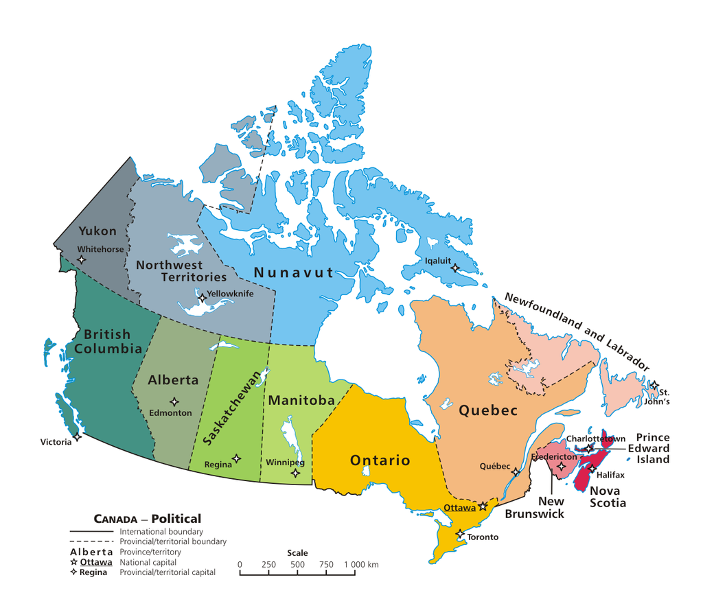
The Canadian landscape
Public healthcare system
Funded at national level
Delivered at national, provincial, territorial & sometimes regional level

Slide 5

Infoway
Jointly funded by provinces & federal government
Mission: accelerate the development, adoption and effective use of digital health solutions
Initial funding of $1.9 billion CAD (~90 billion rubles)
Subsequently bumped to about $2.4 billion CAD

Slide 6
Standards in Canada
HL7 v2 is common for in-hospital communication
New community focus was principally HL7 v3 messaging
Ended up with provincial silos
Some use of CDA
(FHIR didn’t exist when we allocated most of the money ☹)
Standards fatigue had set in by the time FHIR came along

Slide 7
Canadian use of FHIR

Slide 8
Early days
Initial FHIR core team was Grahame (Australia), Ewout (Netherlands) and me (Canada!)
Shortly after the introduction of FHIR, another Canadian developed the FHIR HAPI interface which has become the FHIR Java reference implementation
Tried to get things moving with our first Canadian FHIR conference in 2015 – FHIR North

Slide 9
Immunization
In production ~ 2 years ago
Trial project in Ontario
Allow reporting and query of patient immunizations
Also allow FHIR representation on paper slips using 2-D barcodes
Driver was mobile-friendliness of FHIR
Feedback was:
Fast & easy to implement, implementers liked it
Drove the creation of a lot of other projects

Slide 10
E-Prescribing
First non-government FHIR project
Supported sharing prescriptions from physician to community pharmacies, secure messaging, dispense notifications
Driver was need to have something “easy” that implementers would actually use
Production in Ontario over 1 year ago
but subsequently in production in at least one other province

Slide 11
FHIR + legacy
Lab results
V2 to providers
FHIR to patients and others
Health reports and birth registry information
XDS + CDA to providers
FHIR + PDF to patients and others

Slide 12
Registries
Provider & Patient registries designed & tested, but not production
Read-only for Patient, read-write for Practitioner
Waiting to determine who potential consumers are
Which is somewhat unusual for a government project…

Slide 13
Planned systems
OAuth service for secure patient identity verification
Consent
eReferral
others…

Slide 14
National scale
Institute responsible for gathering health statistics
Using FHIR to gather discharge, adverse event and other reports
Driven by desire to use “standard” rather than custom syntax
Also interested in ease of use/tools

Slide 15
What else are we doing?
5 working groups drawing from various jurisdictions
Bi-weekly calls
Topics are:
Tooling
Architecture
CDS Hooks
Registries
eReferrals

Slide 16
FHIR North
Annual 1-day conference
Started 3 years ago
Got 260+ attendees at the most recent one
Mixture of connectathon & training
Looking to expand to 2/year

Slide 17
Use Cases

Slide 18

Mobile Friendly
RESTful interface & JSON support are “natural” for web-based solutions
APIs – including Swift make mobile solution easy
Resources are lightweight = faster response times
Documentation appeals to mobile developers, less learning curve

Slide 19
Context-free interfaces
RESTful interface is generic
No need to define message events or payloads
Query what you need
One interface can work for multiple partners & solve multiple communication needs
Extensions allow support for specialized needs
Business rules move from the interface to the access control layer
Faster/more dynamic configuration

Slide 20
Profiling and Validation
Conformance artifacts in FHIR are defined computably and resolvable computably
Allows robust validation, including terminology
Support for automated testing of interfaces
Allows sharing of profiles, clinical practice guidelines
Allows dynamic configuration of application behavior and user interface

Slide 21
Documents that are easier
FHIR allows documents that are easier to use than CDA
Data can easily be consumed and used for other purposes
RESTful interface
Decision support
Etc.
Use documents for what they’re meant for, rather than everything

Slide 22



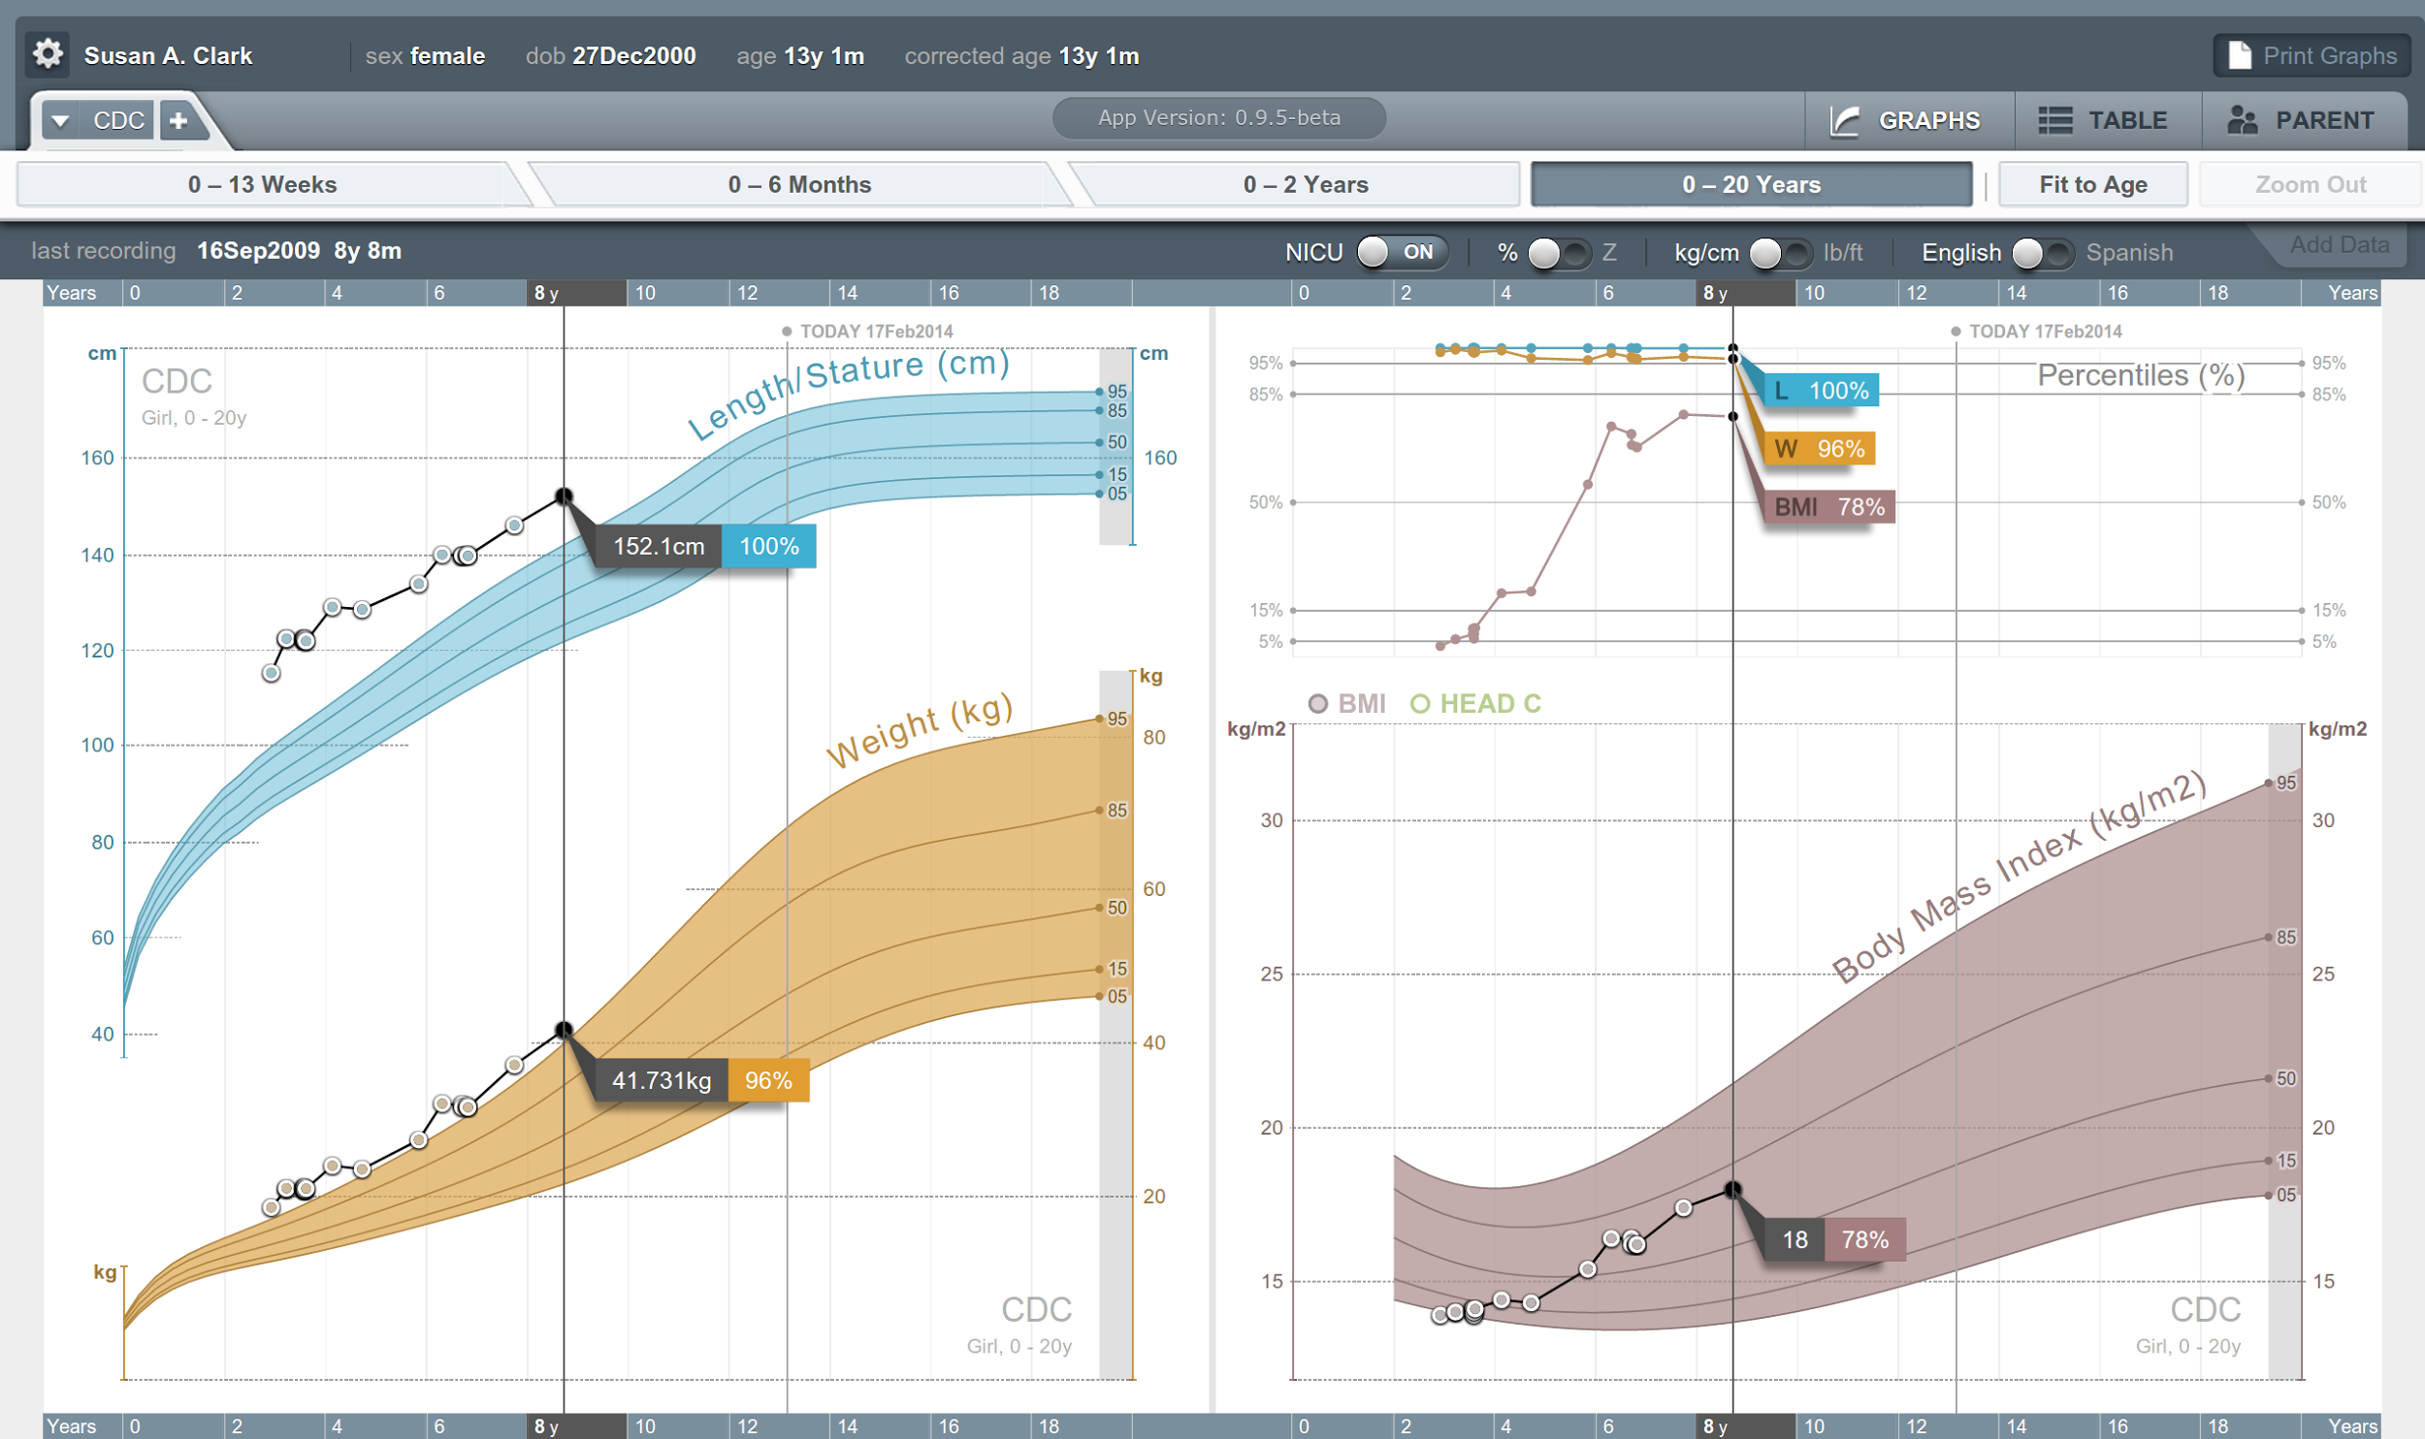


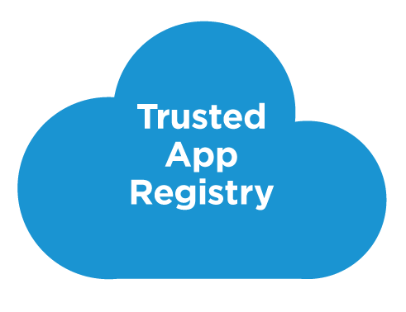



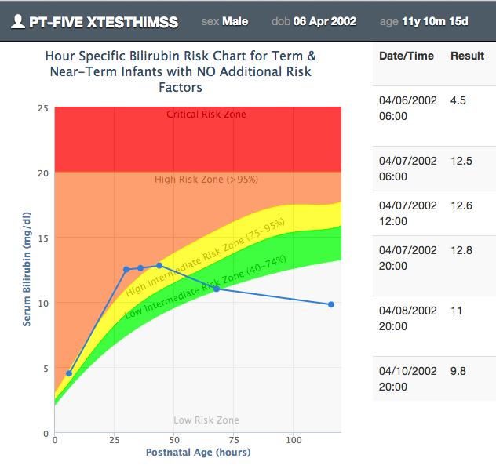

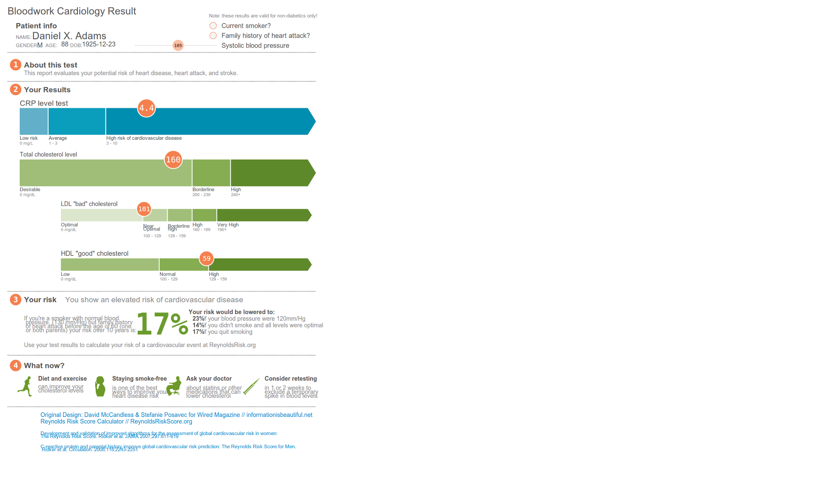





SMART on FHIR
Mobile Apps
Web Apps
OAuth2
REST API
MU-oriented FHIR Data Profiles
Underlying Health IT Systems
Your system here.

Slide 23
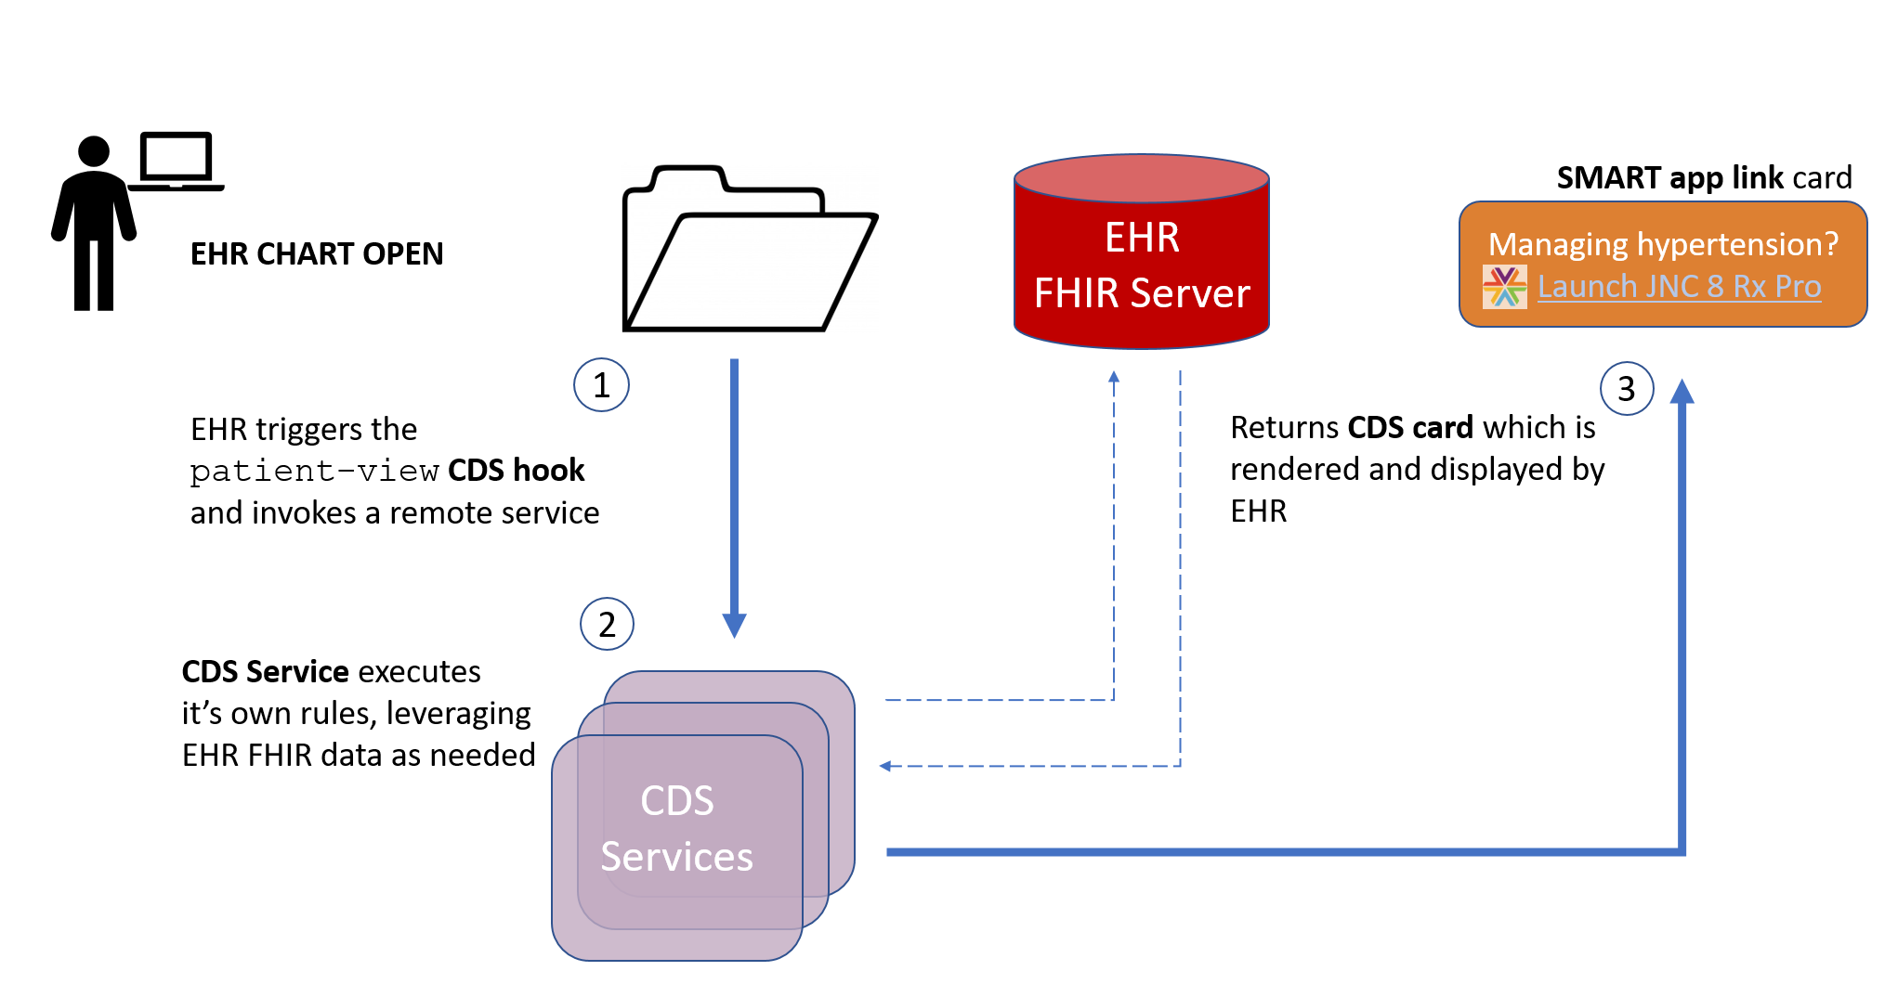
CDS Hooks

Slide 24
Bulk data
Most healthcare interfaces are narrow in scope
Specific patient, specific encounter, specific event
FHIR supports querying whatever’s of interest
All of a patient’s record I’m allowed to see
All data for my patients
All data related to condition X across patients
Subscriptions allow data to be pushed

Slide 25
Leverage the Community
FHIR has attracted far greater attention and energy than any previous HL7 specification
Over 10,000 change requests
Up to 2500 chat.fhir.org messages/week
~180 FHIR-related sessions at most HL7 meetings
Spawned university courses, open source projects, conferences, etc.
That energy attracts implementers and provides better support

Slide 26
Conclusion
Canada has been slower to adopt FHIR, but we’re speeding up
Implementation is happening both from a top-down, government led, but also bottom-up implementer led
The country is trying to build an infrastructure of processes to support future FHIR adoption
FHIR will co-exist with v2, v3 and CDA for quite some time

Slide 27

Questions?
http://hl7.org/fhir lmckenzie@gevityinc.com

